Slide 1
Game BlobBlob
By Vlad Mihai Vasile
Supervisor – Steve Pettifer

Slide 2


Slide 3


Slide 4
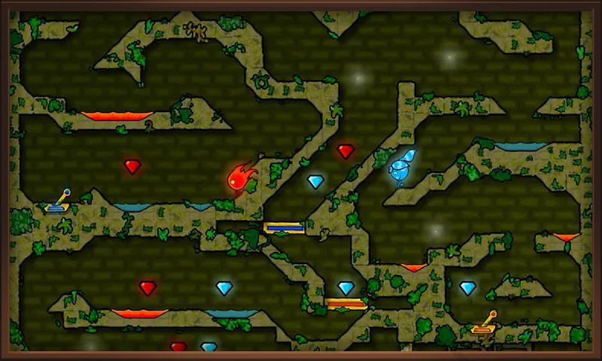

Slide 5
Players
Jumper
Pusher
Enemies
Conjurer
Ranger
Environment
Traps
Obstacles puzzle
Maze
PowerUps

Slide 6
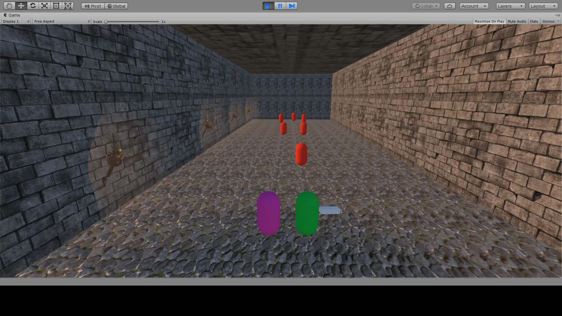

Slide 7
Planning
Expected Goal
Ensure MVP (by Christmas Break)
2 characters working properly, 2 types of enemies (C & R), 2 types of power-ups (Shield, Heal)
Add 3 more types of enemies (first 3 weeks sem 2), Obstacles Puzzle (4th week sem2), remaining time for additional testing, tweaks and wrapping up
Stretch Goals
More types of enemies/power-ups to increase complexity
Add more levels
Improve quality of VFX and SFX

Slide 8
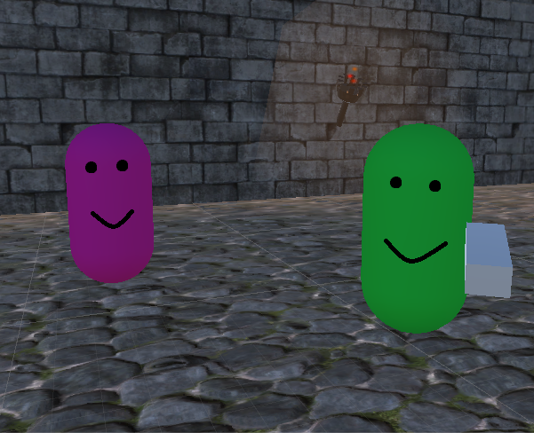
Come join the TicTac Army!

